Slide 1
Adult Income Prediction
Gurtej S. Bains
Freelance Data Scientist
9 Feb 2023

Slide 2

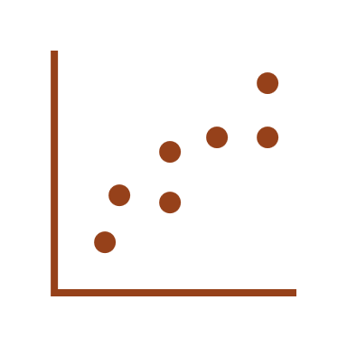

Executive Summary
Problem Statement
Bureau of Labor Statistics officials seek to understand what factors influence the annual income of citizens in the United States.
Annual income and various demographic data were collected by the US Census Bureau in 1996.
Analytical Approach
Machine Learning Models were used to predict annual income, which was classified into two categories, namely above and below $50K.
These models are very powerful and suitable tools for dealing with such business problems.
Accuracy in the number of times the annual income was accurately predicted by the model was used as a key performance indicator for performance.
Key Findings
Model results are not satisfactory, indicating an expansion of the scope in data collection.
In the current state of the data, the annual income of citizens in the United States cannot be satisfactorily explained.
Further technical enhancements to the model are highly recommended as immediate next steps to improve predictive power. These enhancements could not be scoped in the initial study because of resource constraints.

Slide 3
Let’s talk data..
Source Data Facts
48,842 observations in the data*
Data has 15 columns capturing primarily the demographics
No PII shared
Garbage in is equal to garbage out
Some assumptions-based data cleaning was performed, for instance 6% of observations had a missing Work Class.
76% of the observations have annual income
of less than $50K
Private sector is the most popular Work Class
<=$50k
>$50k
76%
76%
24%
Heat map showing cumulative total of employment in a work class by gender and annual income bin
*Data collected in 1996. For reference US population in 1996 was approximately 270M

Slide 4
Irrespective of age, people earning $50K+ annually on an average work 6.3 additional hours per week
Avg: 6.3 hours
*Additional hours relative to the lower income group

Slide 5
People earning $50K+ annually on an average are making higher net capital gains, while significant spikes observed for some ages
Average Net Capital Gains is a calculated field not present in the data. Formula used = Capital Gains – Capital Loss

Slide 6

Let’s talk model..
Model Results
Out of all the models, Grid Search Tuned Random Forest Model is the winner with an accuracy score of 85%.
However, the model did not show satisfactory performance in predicting the annual income above $50K.
Only for 46% of instances it was accurately able to predict the salary above $50K.
Proposed Next Steps
Massage the existing data:
Feature engineer or massaging the existing data to make it more model readable. For example, education can be classified as 'doctoral', 'master', 'bachelor', or ‘high school or less’.
Outlier treatment: Outliers are identified in the hours-per-week feature.
Explore third party data sources.
Existing data is not able to explain the annual salary. We should augment the model by exploring third party data.
Progress report in 30 days.

Slide 7
Appendix

Slide 8
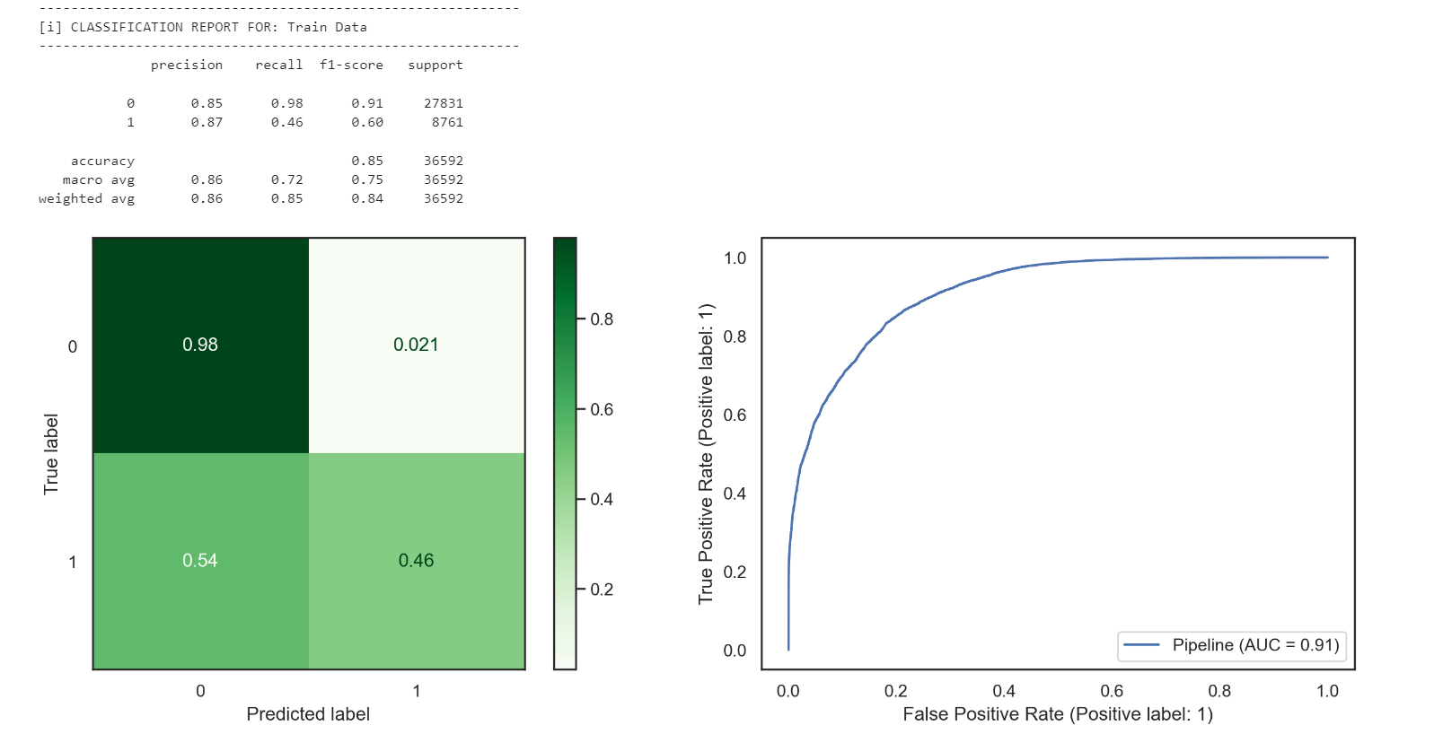
Winning Model Output

